Slide 1
Invertible

Slide 2

Unique Invertibles

Slide 3
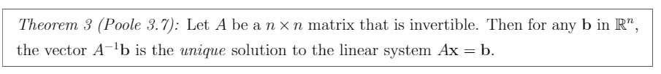
Invertible Unique Solution

Slide 4

Invertible Homogenous Solution

Slide 5
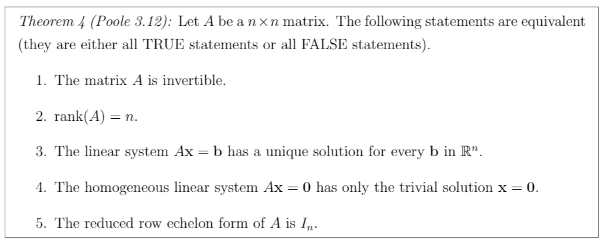
Invertible Properties
Fundamental Theorem of Invertible Matrices

Slide 6
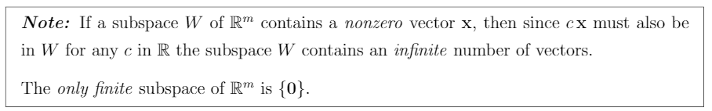
Subspace nonzero Vector

Slide 7

Subspace and Span

Slide 8
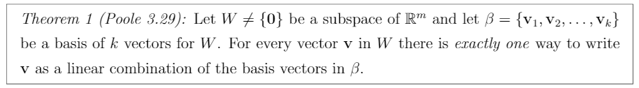
Basis and Span

Slide 9
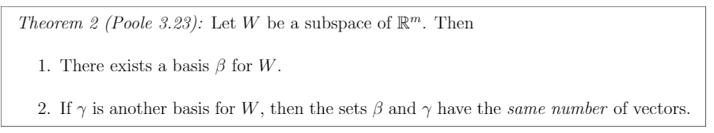
Dupe Subspaces

Slide 10
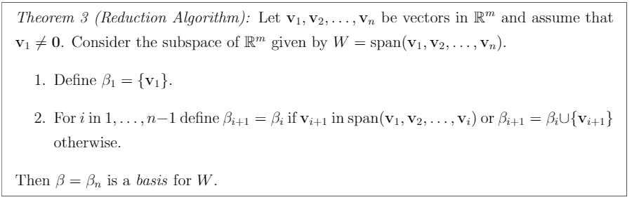
Reduction Algorithm

Slide 11
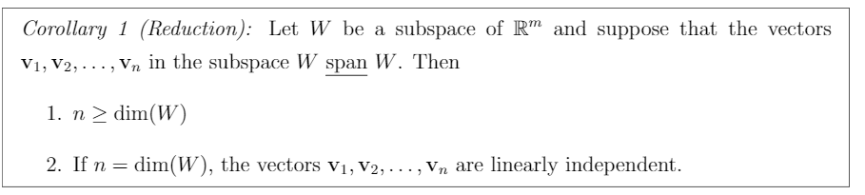
Reduction Corollary

Slide 12
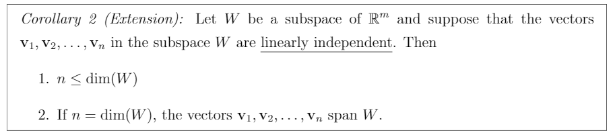
Extension Corollary

Slide 13
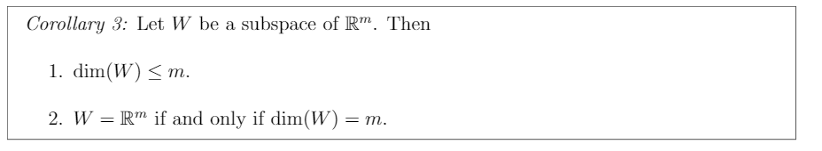
Subspace Properties

Slide 14
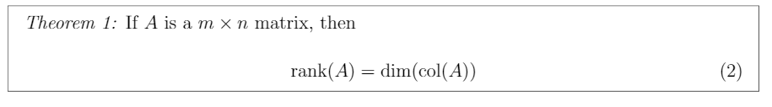
Rank & Column Dimension

Slide 15
Null and Subspace

Slide 16
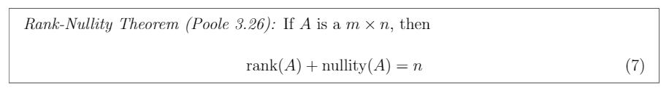
Rank Nullity Theorem

Slide 17
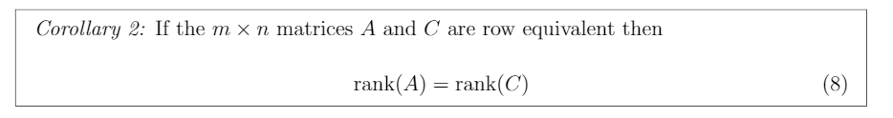
Row Equivalent Rank

Slide 18
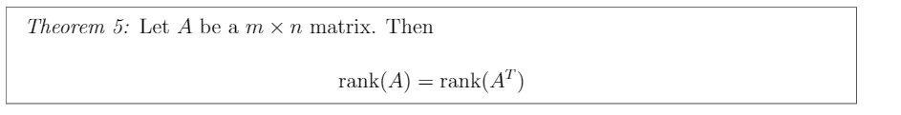
Rank vs Rank Transpose

Slide 19
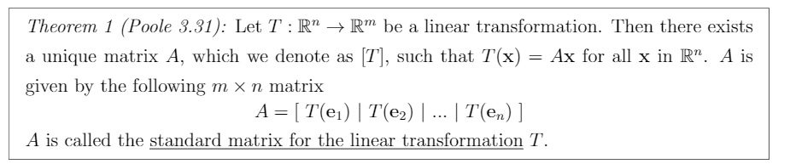
Standard Matrix

Slide 20
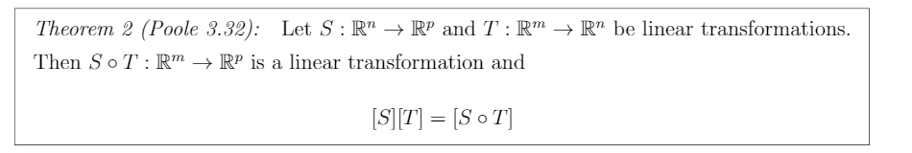
Standard Matrix Multiplication????

Slide 21
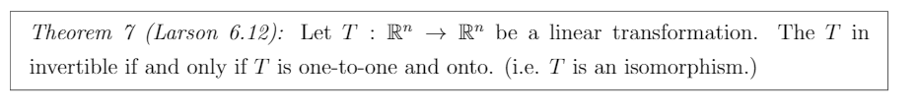
Isomorphism

Slide 22
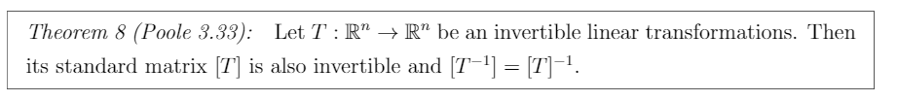
Invertible Linear Transformation and Standard Matrix

